Slide 1

ReServe
Created by:
Richard Compton (Display)
Mary Shiner (Display)
Kevin Kaminski (Database)
Kelly Kurkowski (Database)
Selena Haidar (Middleware)
Seth Logan (Middleware)
Elias Qumsieh (Middleware)
Sprint 1!
Notes:
We introduce ourselves.

Slide 2




ReServe Refresher
We are creating a web & mobile application that will help restaurants accurately calculate wait times, giving a more enjoyable experience to the consumer.
High Level User Stories:
As a restaurant manager, I want to easily configure, manage and reconfigure a seating area.
As a restaurant manager, I want to quickly estimate my restaurant's average occupancy and wait time.
As a restaurant manager, I want to store my restaurant's information in a concise, clean medium
As a customer, I want to easily and accurately reserve a table.
As a customer, I want to swiftly know the current wait time.
We are using Microsoft Visual Studio, C# as the primary programming language, T-SQL for the database, and Windows Server to host the web server.
Other Important Information:
ASP.NET framework
GitHub for version control
Trello for project management
Slack for communication (GitHub integration)
Meet up to twice/week in-person
Xamarin for mobile application
Notes:
KELLY

Slide 3
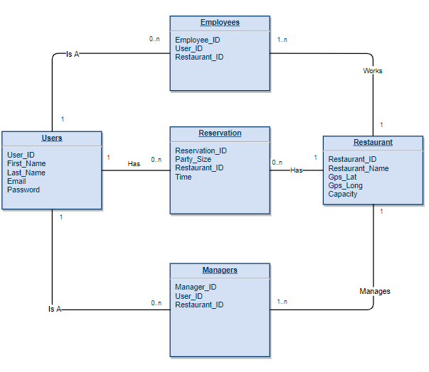
Current UML
Notes:
SETH

Slide 4
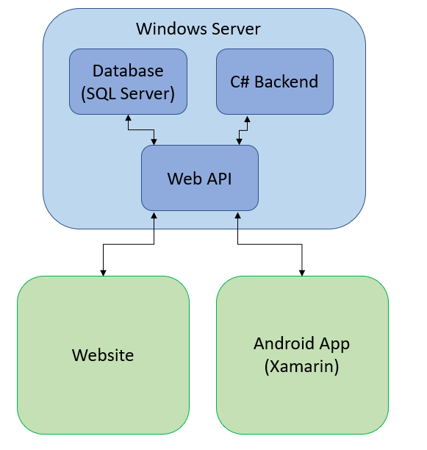
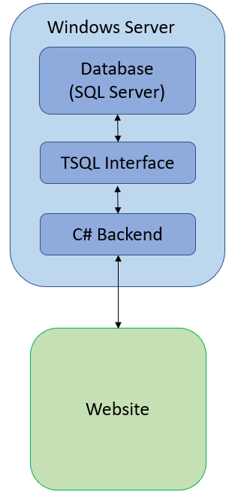
High Level Design
Notes:
SETH

Slide 5
Business Analysis
Researched for the requirements to develop the login mechanism
Understand how the logic behind the page will behave
Divide the work into three parts, display, middleware, and database
Provide a detailed document that assign the work to the sub groups
Presented a temporary way to combine works together
Notes:
ELIAS

Slide 6
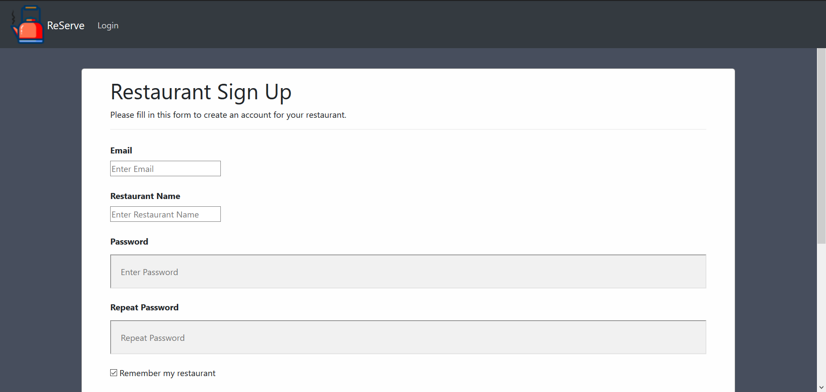
Registration: Restaurants
Managers can register their restaurant. In future builds, they will be able to configure seating areas using a drag and drop interface.
Notes:
RJ: I spent the majority of Sprint 1 working on the frontend of ReServe. I spent hours researching, studying, and practicing HTML and then I began coding the front end. I made 3 pages for Sprint 1: the restaurant sign up, guest reservation, and restaurant selection pages. Currently, they are used to create users for our system, primarily restaurant manager users, but will be used for quite a lot more in the future. For example, the restaurant sign up page will launch the seating area creator after Sprint 2. Managers will be able to configure seating areas using a drag and drop interface and a variety of different sized and shaped tables. Eventually, this will connect to our grand wait time calculation. As for email authentication, that will be handled during Sprint 2 when we secure our web server.

Slide 7
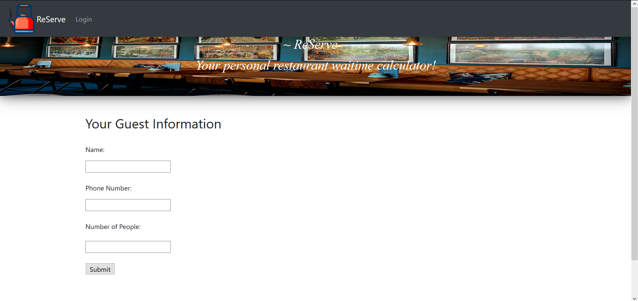
Registration: Customers
Customers can send their name, phone number, and number of people in their party to the database. In future builds, they will be able to choose a specific restaurant, reserve a seat, and learn their wait time.
Notes:
RJ: currently, on the customer side, customers can send their name, phone number, and number of people in their party to the database. No other functionality is available for the time being. In the future, they will be able to choose a specific restaurant, reserve a seat, learn their wait time, and be notified via SMS that their seat is ready for them.

Slide 8
Database
Table
Main Class
Method
Combining projects inside Visual Studio
Visual Studio Installer
Notes:
KEVIN

Slide 9





Web Application Tools
Visual Studio
Bootstrap
W3 Schools
FreeFavicon
Pexels
Notes:
Mary - talk about tools

Slide 10
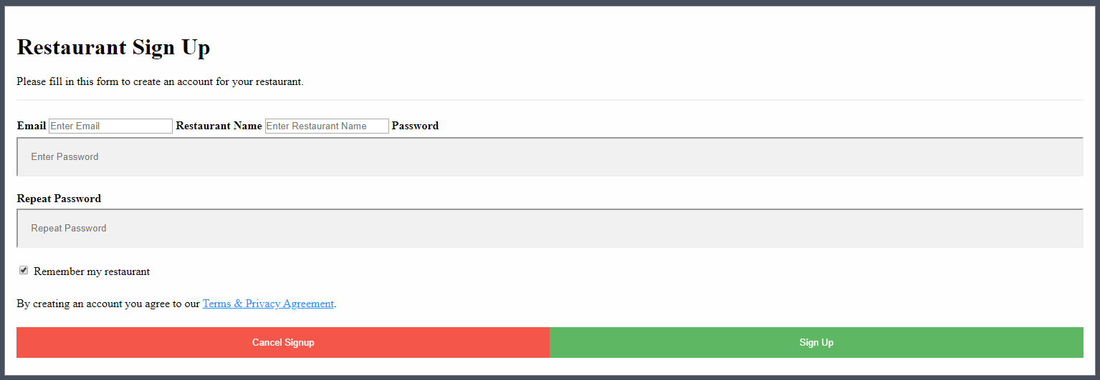
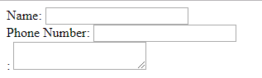
Initial Web Application Skeleton
Notes:
RJ: This is what my pure HTML looked like when I initially coded these two pages. Bland, basic, some would say ugly. I tried my hand at some CSS — tried to beautify my code — but in the end I went to Mary for help. She was able to make the pages look fantastic, as you’re about to see.

Slide 11
Current Web Application Skeleton
Notes:
Mary - CSS, skeleton

Slide 12
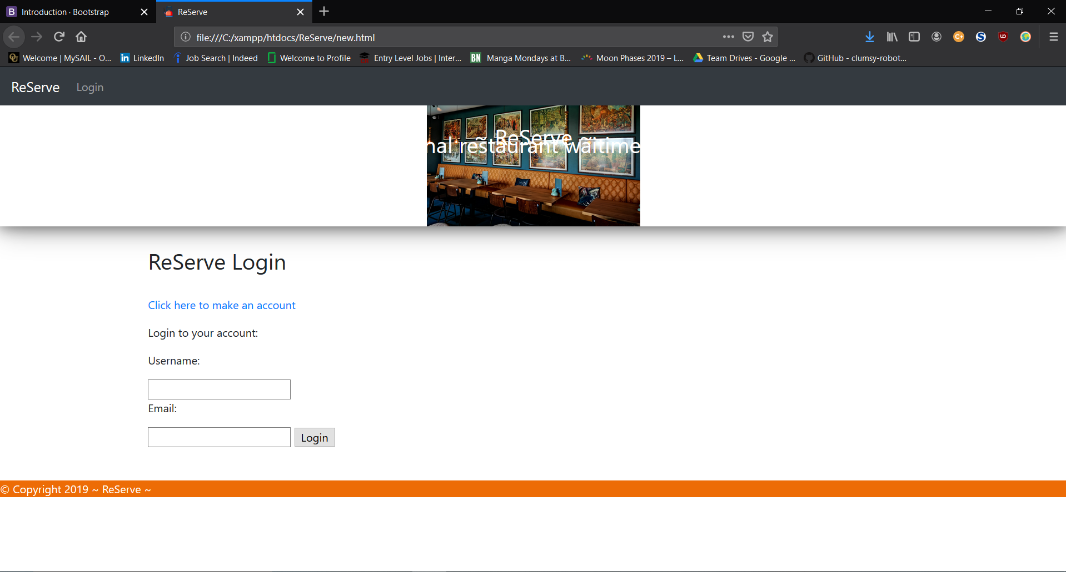
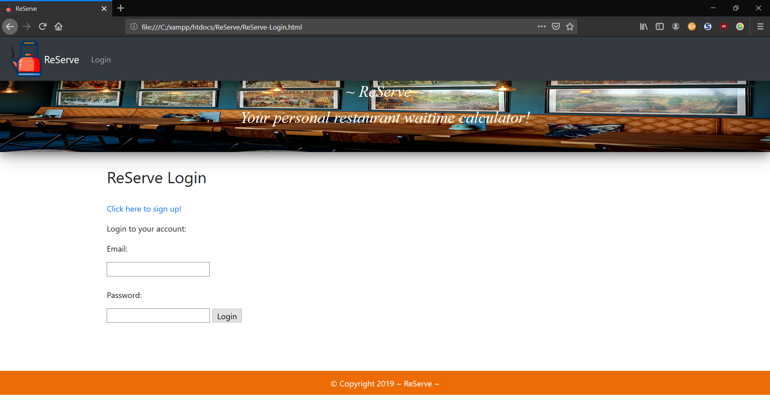
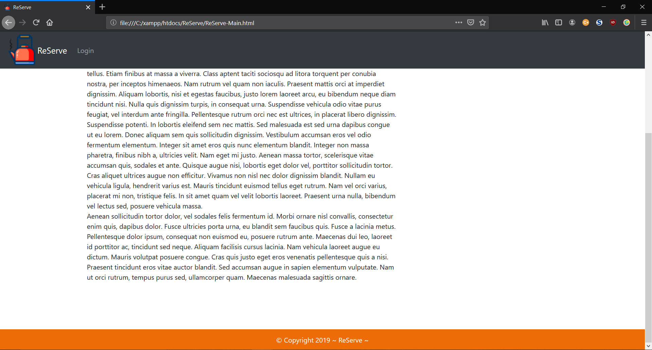
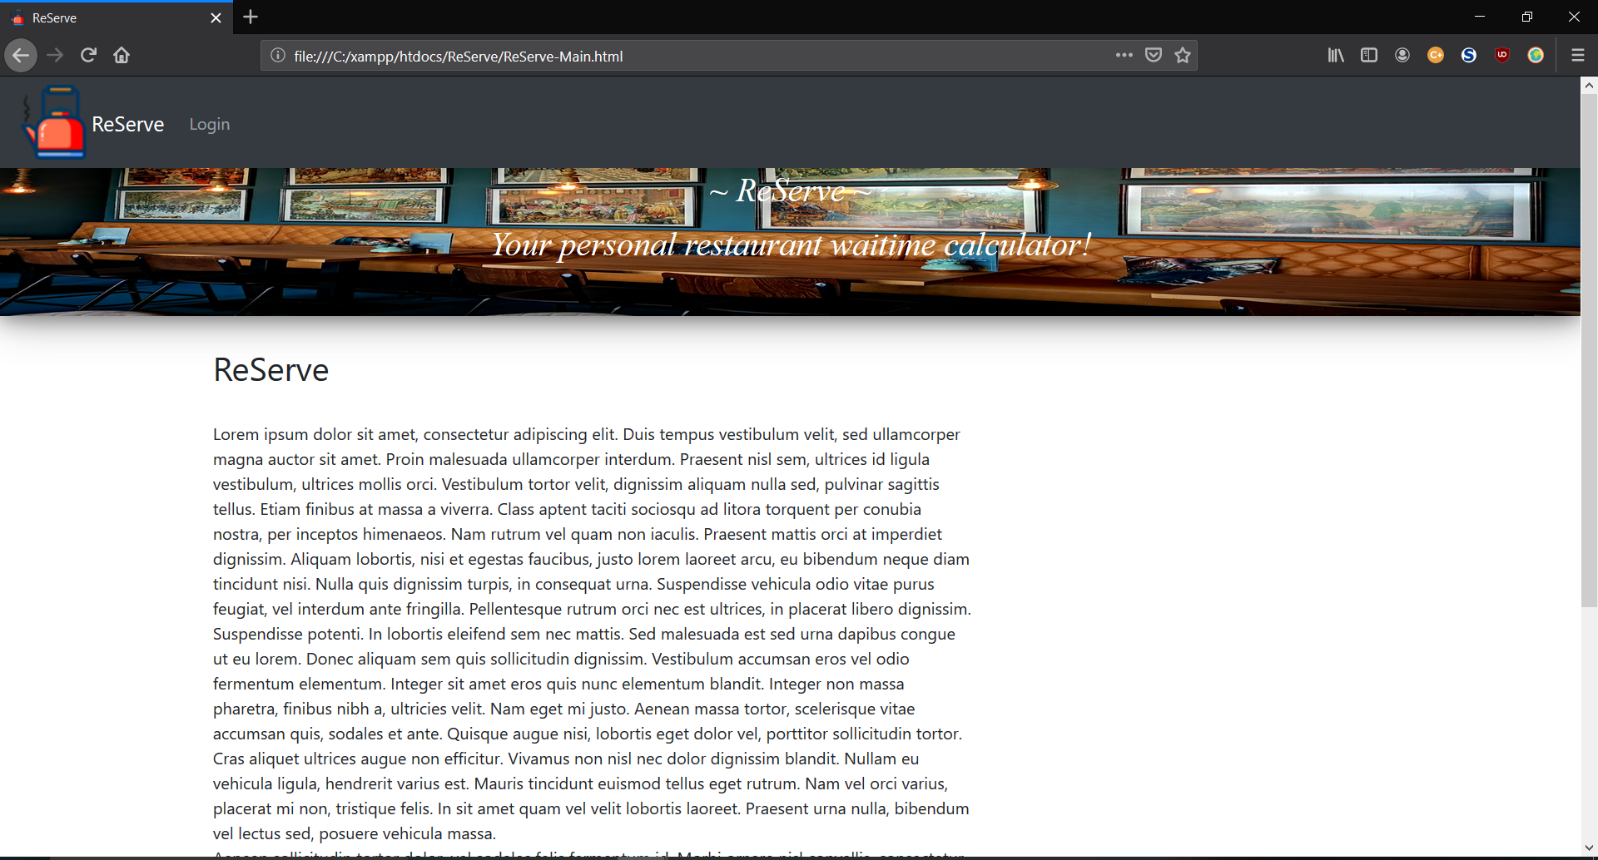
Current Web Application Skeleton
Notes:
Mary

Slide 13
Current Risks & Challenges
Adjusting to new ideas and bumps in the road
Clear communication
Keeping scope limited and focused
Combining everyone’s code at the end of a sprint
Notes:
ELIAS

Slide 14
Risk Mitigation
Daily communication on Slack
Meetings in-person twice a week
Expert GitHub management
Splitting up into teams (Display, Middleware, Database/Mobile)
Notes:
SELENA

Slide 15
Sprint 2 Objectives
Establish the notification process.
Complete the layout of all the web pages.
Create a click, drag, and drop restaurant layout skeleton.
Work on the mobile application’s GUI and integration.
Compile research about restaurant wait times and create a formula to calculate an average.
Notes:
KELLY

Slide 16
Demonstration Time
Notes:
EVERYONE, SETH’S COMPUTER FOR DEMONSTRATION AND PRESENTATION: Create a restaurant, login with that account, create customer, not login

Slide 17
Questions?
Notes:
We ask if there are any questions.

